Slide 2



Diving into Mastery Guidance for Educators
Each activity sheet is split into three sections, diving, deeper and deepest, which are represented by the following icons:
These carefully designed activities take your children through a learning journey, initially ensuring they are fluent with the key concept being taught; then applying this to a range of reasoning and problem-solving activities.
These sheets might not necessarily be used in a linear way. Some children might begin at the ‘Deeper’ section and in fact, others may ‘dive straight in’ to the ‘Deepest’ section if they have already mastered the skill and are applying this to show their depth of understanding.
Diving
Deeper
Deepest

Slide 3
National Curriculum Aim
Multiply multi-digit numbers up to 4 digits by a two-digit whole number using the formal written method of long multiplication

Slide 4

Multiply up to a 4-Digit Number by a 2-Digit Number
Diving
Use long multiplication to complete each calculation.
5604 × 37
6384 × 29
 |  | 5 | 6 | 0 | 4
 | × |  |  | 3 | 7
 | 3 | 9₄ | 2 | 2₂ | 8
1 | 6₁ | 8 | 1₁ | 2 | 0
2 | 0 | 7 | 3 | 4 | 8
1 | 1
 |  | 6 | 3 | 8 | 4
 | × |  |  | 2 | 9
 | 5 | 7₃ | 4₇ | 5₃ | 6
1 | 2 | 7₁ | 6 | 8 | 0
1 | 8 | 5 | 1 | 3 | 6
 | 1 | 1 | 1
(5604 × 7)
(6384 × 9)
(5604 × 30)
(6384 × 20)

Slide 5
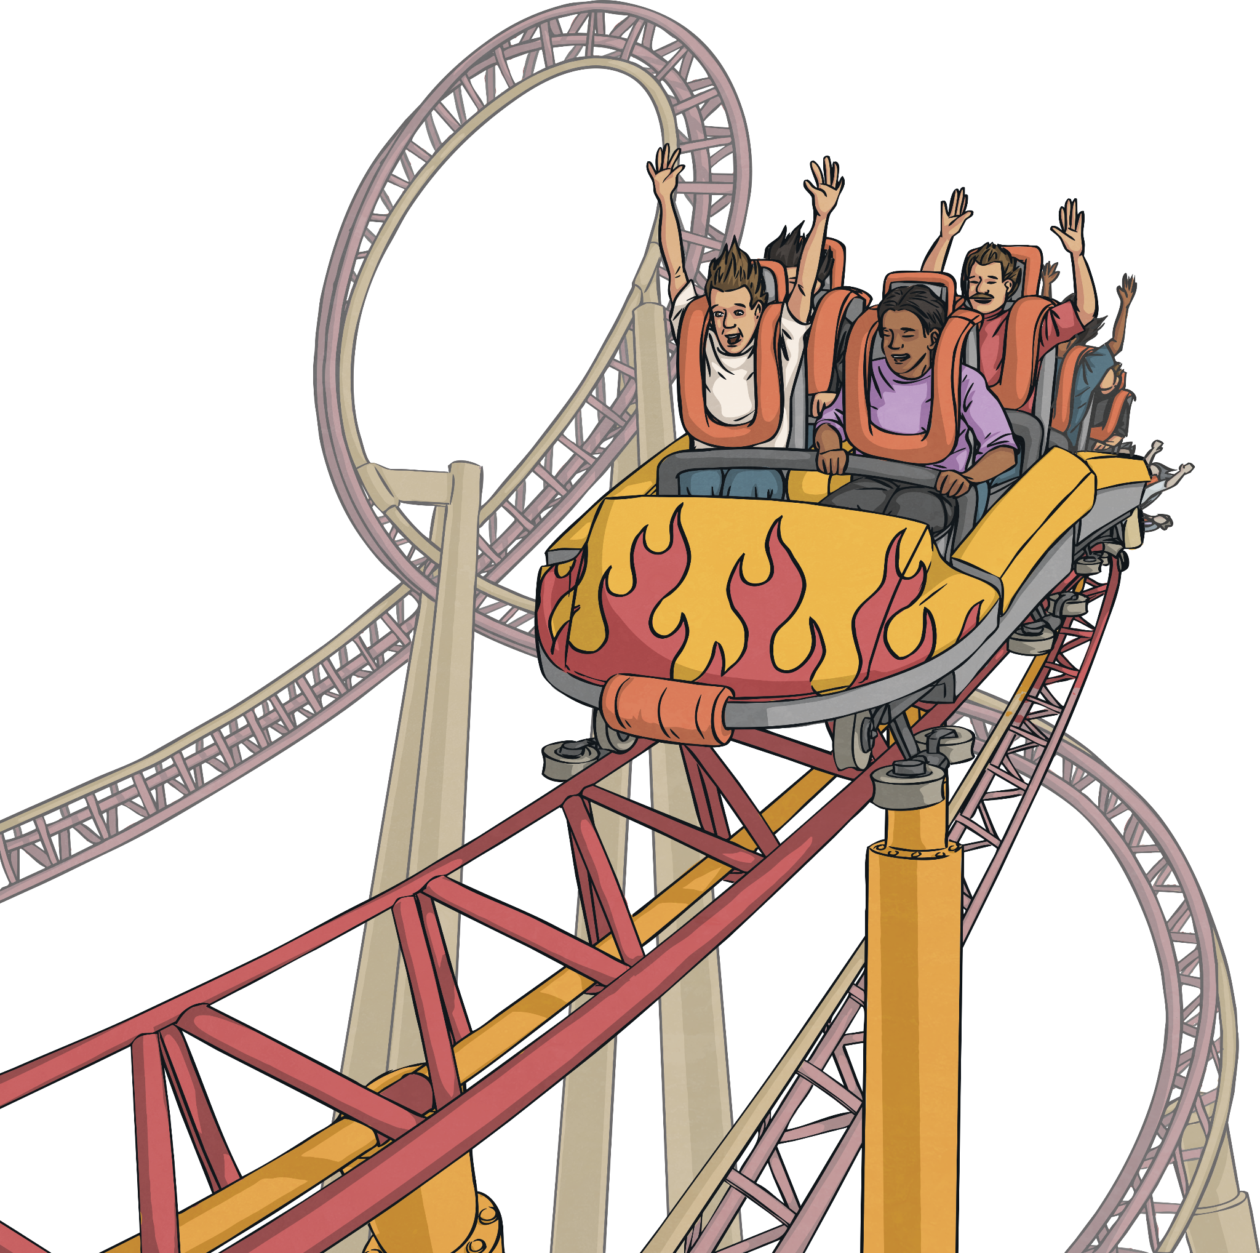
Multiply up to a 4-Digit Number by a 2-Digit Number
Diving
A large group of people are going on a trip to a theme park. There are 42 groups with 29 children in each group. 39 grandparents and 16 parents are also going.
If each ticket costs £26, how much will all
the tickets cost?
42 × 29 = 1218, 1218 + 55 = 1273
1273 × £26 = £33 098
 | 1 | 2 | 7 | 3
× |  |  | 2 | 6
 | 7₁ | 6₄ | 3₁ | 8
2 | 5₁ | 4 | 6 | 0
3 | 3 | 0 | 9 | 8
1 | 1
(1273 × 6)
(1273 × 20)

Slide 6
Multiply up to a 4-Digit Number by a 2-Digit Number
Diving
42 × 29 = 1218, 1218 + 55 = 1273
1000
200
70
3
20
20 000 | 4 000 | 1400 | 60
6000 | 1200 | 420 | 18
6
20 000 + 6000 + 4000 +1200 + 1400 + 420 +60 +18 = £33 098

Slide 7

Multiply up to a 4-Digit Number by a 2-Digit Number
Deeper
Insert White Rose Aim Here
Joseph has completed this long multiplication calculation but has made some mistakes. Explain each mistake and calculate the correct answer.
When multiplying by the ones digit, Joseph has incorrectly regrouped.
2 × 6 = 12 (1 ten and 2 ones) but he has written this as 2 tens and 1 one.
8416 × 2 = 16 832
When multiplying by the tens digit, he has not included a zero placeholder.
8416 × 60 = 504 960
The correct answer is
521 792.
 |  | 8 | 4 | 1 | 6
 | × |  |  | 6 | 2
 | 1 | 6 | 8 | 4₂ | 1
 | 5 | 0₂ | 4 | 9₃ | 6
 | 6 | 7 | 3 | 3 | 7
 |  | 1 | 1
(8416 × 2)
(8416 × 60)

Slide 8
Multiply up to a 4-Digit Number by a 2-Digit Number
Deeper
Insert White Rose Aim Here
Identify the missing digits shown by the letters and explain which is the odd one out. Calculate the answer to the calculation.
 |  | A | 0 | 3 | 1
 | × |  |  | B | 2
 |  | 8 | 0 | C | 2
1 | 6 | 1₁ | 2 | D | 0
 |  | 4 | 0 | 3 | 1
 | × |  |  | 4 | 2
 |  | 8 | 0 | 6 | 2
1 | 6 | 1₁ | 2 | 4 | 0
1 | 6 | 9 | 3 | 0 | 2
 |  |  | 1
A = 4, B = 4, C = 6 and D = 4 so C is the odd one out as this is the only digit that is not a 4.

Slide 9


Multiply up to a 4-Digit Number by a 2-Digit Number
Deepest
At a rugby stadium, 6413 spectators bought a snack costing 72p each. 5896 bought a drink costing 95p each.
6413 × 72p = £4617.36
5896 × 95p = £5601.20
£5601.20 − £4617.36 = £983.84
How much more money did they take selling drinks than selling snacks?
How much money did they take altogether?
£5601.20 + £4617.36 = £10 218.56

Slide 10
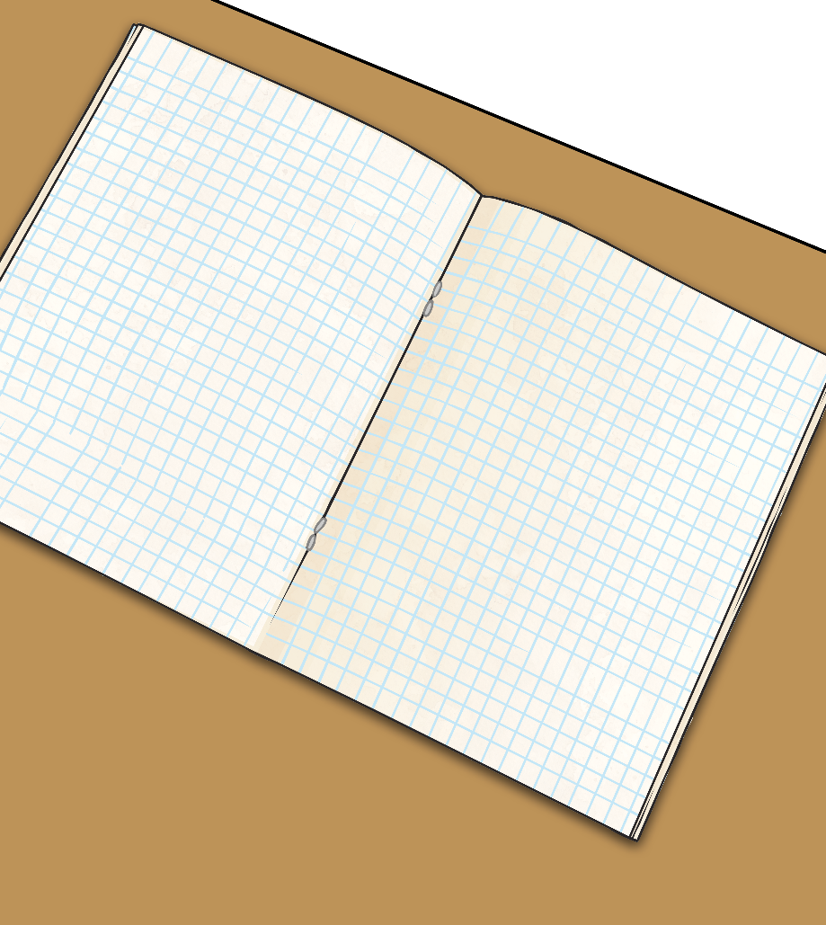
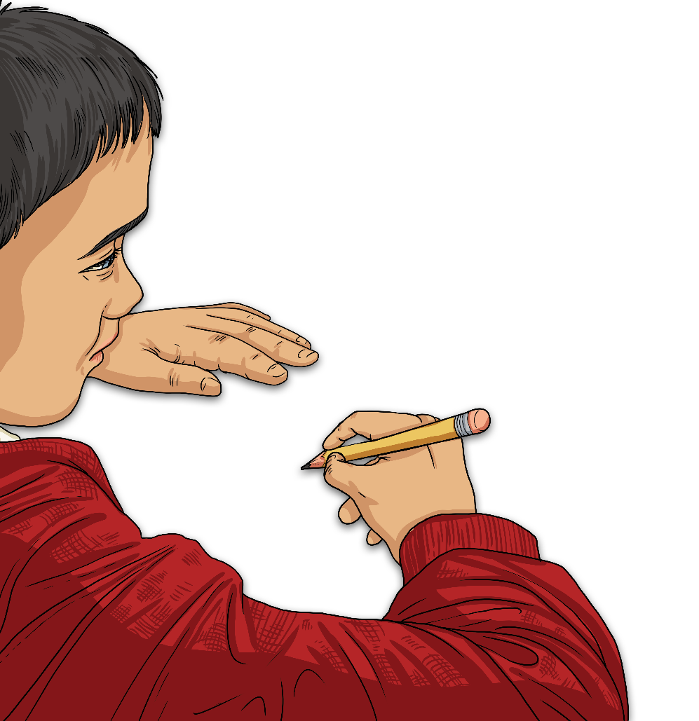
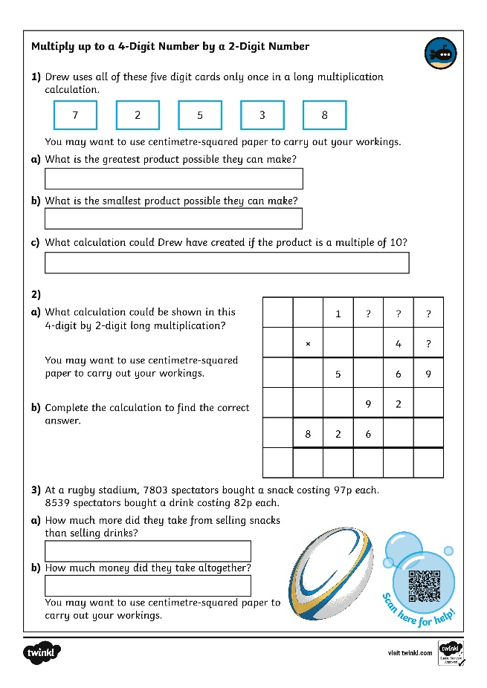
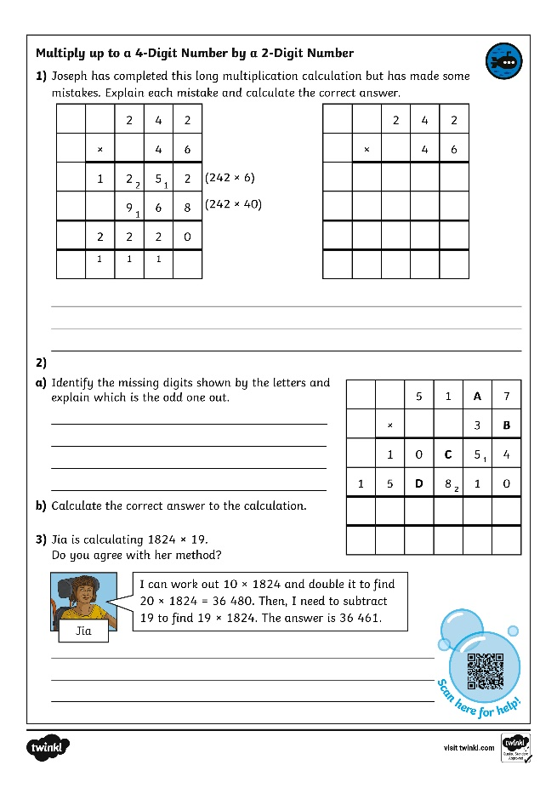
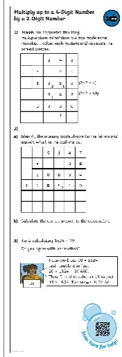
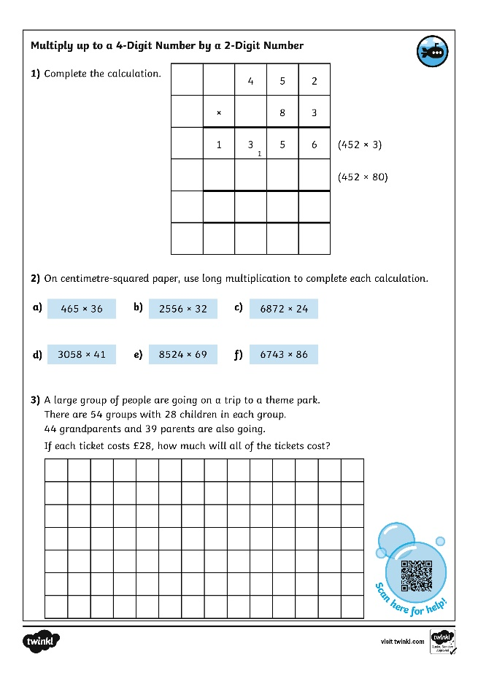
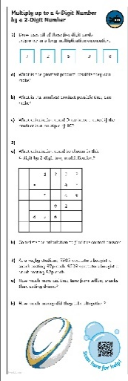
Multiply up to a 4-Digit Number by a 2-Digit Number
Dive in by completing your own activity!

Slide 11
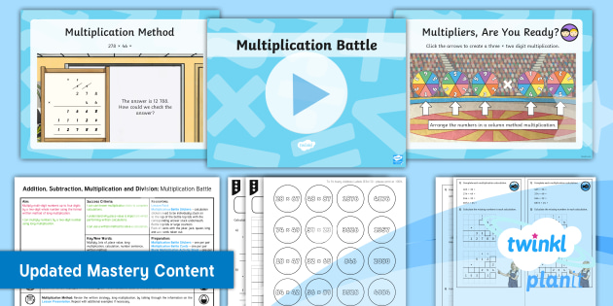
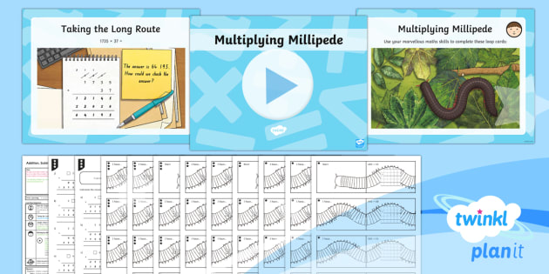

Need Planning to Complement this Resource?
National Curriculum Aim
Solve problems involving addition, subtraction, multiplication and division
For more planning resources to support this aim, click here.
Twinkl PlanIt is our award-winning scheme of work
with over 4000 resources.

